Slide 1


Electric Circuits
Twelfth Edition, Global Edition
Chapter 9 – Part 3
Sinusoidal Steady-State Analysis
© 2024 Pearson Education Ltd. All Rights Reserved
Notes:
If this PowerPoint presentation contains mathematical equations, you may need to check that your computer has the following installed:
1) Math Type Plugin
2) Math Player (free versions available)
3) NVDA Reader (free versions available)

Slide 2
Chapter 9 – Sinusoidal Steady-State Analysis (1 of 26)
Steps in A C S S Analysis:
Redraw the circuit (the phasor transform does not change the components or their connections).
Phasor transform all known v(t) and i(t).
Represent unknown voltages and currents with V and I.
Replace component values with impedance (Z) values.
Use any circuit analysis method(s) to write equations and solve them with a calculator.
Inverse-transform the result, which is a phasor, back to the time domain.

Slide 3
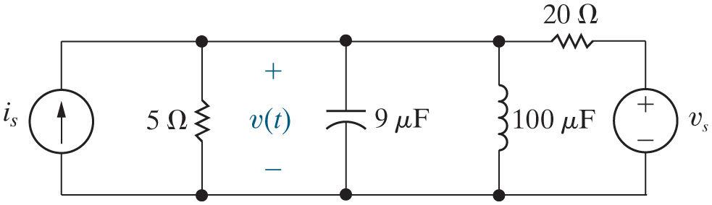




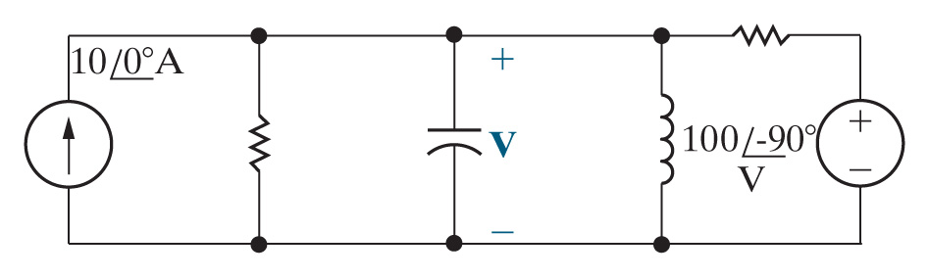
Chapter 9 – Sinusoidal Steady-State Analysis (2 of 26)
Example:
Find v(t) in the steady-state.
Redraw the circuit.
Phasor transform all known voltages and currents.
Represent unknown voltages and currents with phasor symbols

Slide 4
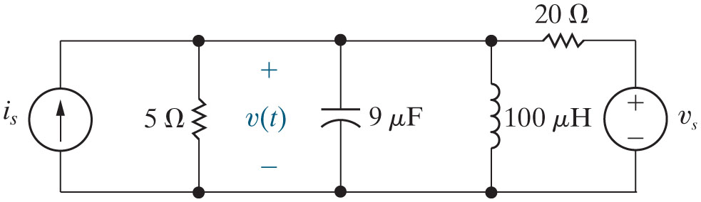
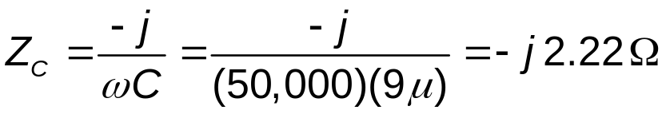
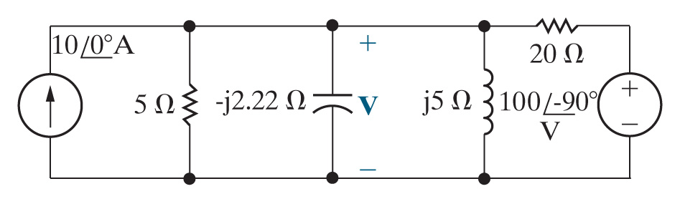
Chapter 9 – Sinusoidal Steady-State Analysis (3 of 26)
Example (continued):
Find v(t) in the steady-state.
Calculate the impedances of all resistors, inductors, and capacitors.

Slide 5


Chapter 9 – Sinusoidal Steady-State Analysis (4 of 26)
Which of the following circuit analysis techniques provides a one-equation method to find the phasor voltage?
A. Mesh current method
B. Source transformation
C. Node voltage method

Slide 6
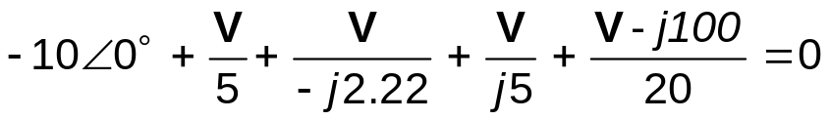
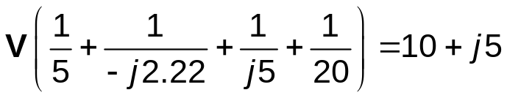

Chapter 9 – Sinusoidal Steady-State Analysis (5 of 26)
Example (continued):
Find v(t) in the steady-state.
Use D C circuit analysis techniques to find the phasor V.
  Use the node voltage method.

Slide 7

Chapter 9 – Sinusoidal Steady-State Analysis (6 of 26)
In writing the equations previously, we replaced the complex
number
with −j100. Your calculator can do this for
you by putting its representation of complex numbers in
A. Rectangular form
B. Polar form
C. Approximate form

Slide 8



Chapter 9 – Sinusoidal Steady-State Analysis (7 of 26)
Convert the complex number -15 to polar form.
A.
B.
C.

Slide 9
Chapter 9 – Sinusoidal Steady-State Analysis (8 of 26)
Example (continued):
Find v(t) in the steady-state.
Inverse phasor-transform the result to get back to the time domain.

Slide 10
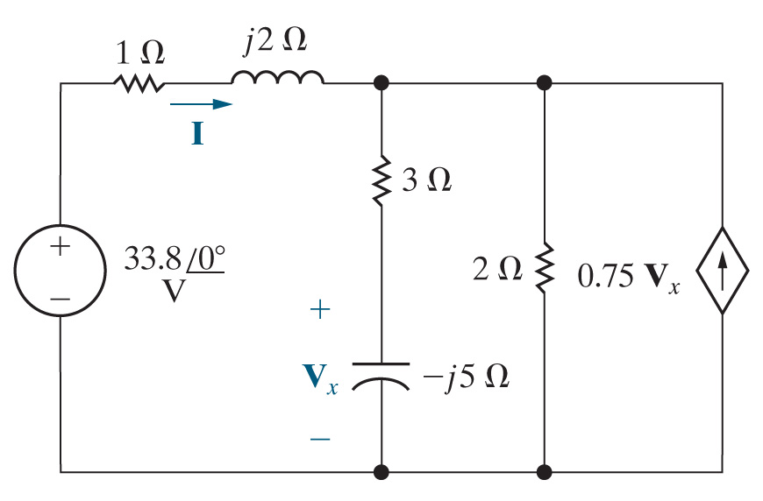
Chapter 9 – Sinusoidal Steady-State Analysis (9 of 26)
Example:
Find the value of the phasor current I in the phasor-transformed circuit shown.
Use D C circuit analysis techniques to find the phasor I.

Slide 11
Chapter 9 – Sinusoidal Steady-State Analysis (10 of 26)
Which of the circuit analysis methods below will generate equations that, when solved, directly result in the value of the phasor current?
A. Node voltage method
B. Mesh current method
C. Source transformation

Slide 12



Chapter 9 – Sinusoidal Steady-State Analysis (11 of 26)
Example (continued):
Find the value of the phasor current I in the phasor-transformed circuit shown.
Mesh current equations:
Standard form:

Slide 13



Chapter 9 – Sinusoidal Steady-State Analysis (12 of 26)
Example (continued):
Find the value of the phasor current I in the phasor-transformed circuit shown.
Solving:

Slide 14
Chapter 9 – Sinusoidal Steady-State Analysis (13 of 26)
In preparation for the inverse phasor transform, we need to convert the phasor current to
A. Rectangular form
B. Polar form
C. Standard form

Slide 15
Chapter 9 – Sinusoidal Steady-State Analysis (14 of 26)
If we convert 29 + j2 to polar form, its phase angle will be
A. Positive
B. Negative
C. I need my calculator!

Slide 16
Chapter 9 – Sinusoidal Steady-State Analysis (15 of 26)
Example (continued):
Find the value of the phasor current I in the phasor-transformed circuit shown.
Inverse phasor-transform the result to get back to the time domain. We don’t have to complete this step for this problem!

Slide 17

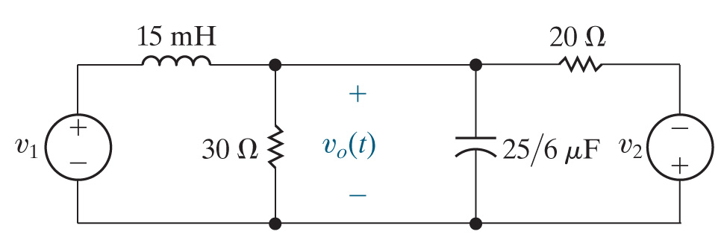




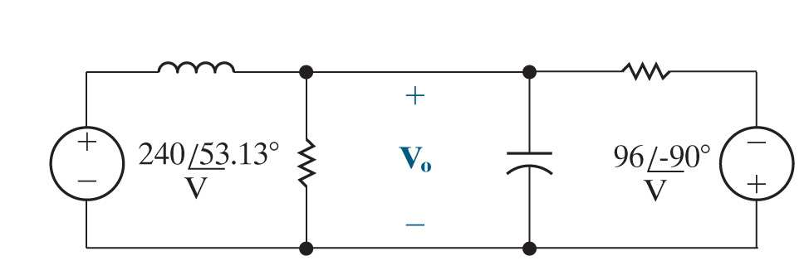
Chapter 9 – Sinusoidal Steady-State Analysis (16 of 26)
Example:
Find
in the steady-state, using a
series of source transformations.
Redraw the circuit.
Phasor transform all known voltages and currents.
Represent unknown voltages and currents with phasor symbols

Slide 18

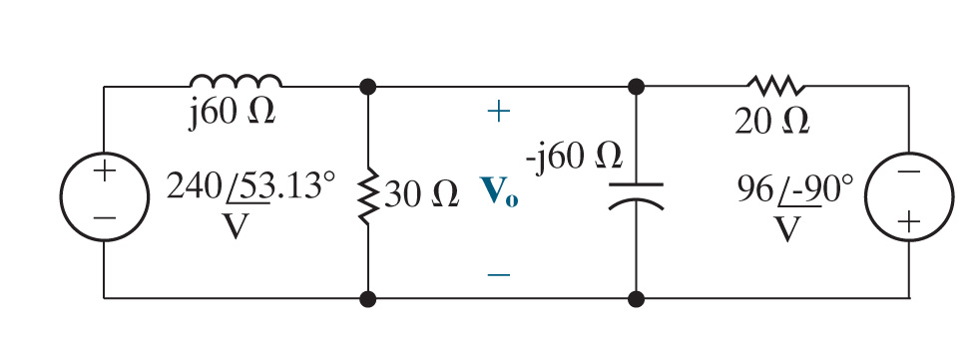
Chapter 9 – Sinusoidal Steady-State Analysis (17 of 26)
Example (continued):
Find
in the steady-state, using a
series of source transformations.
Calculate the impedances of all resistors, inductors, and capacitors.

Slide 19
Chapter 9 – Sinusoidal Steady-State Analysis (18 of 26)
We can check our impedance values to be sure that the resistor impedances are Fill in the blanks and the capacitor impedances are Fill in the blanks .
A. Positive real numbers; negative real numbers
B. Positive real numbers; negative imaginary numbers
C. Positive imaginary numbers; negative imaginary numbers

Slide 20

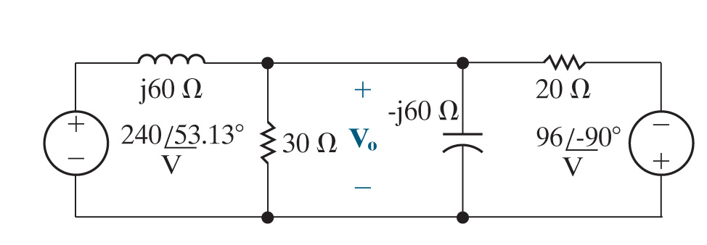
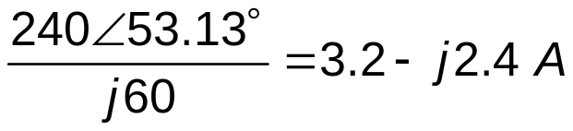
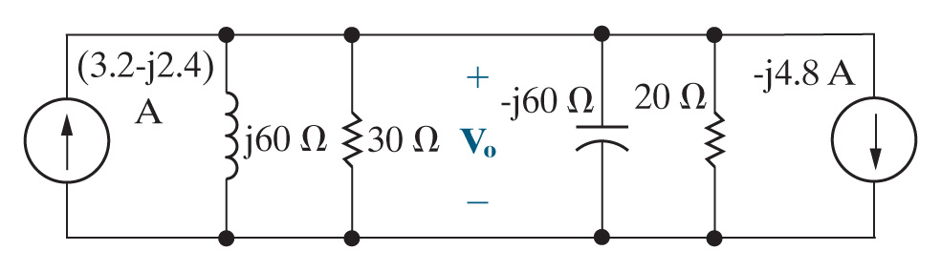
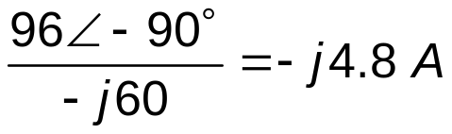
Chapter 9 – Sinusoidal Steady-State Analysis (19 of 26)
Example (continued):
Find
in the steady-state, using a series of source transformations.
Source transform

Slide 21



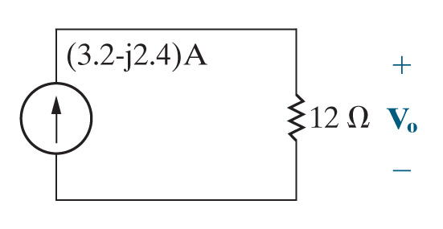
Chapter 9 – Sinusoidal Steady-State Analysis (20 of 26)
Example (continued):
Find
in the steady-state, using a series of source transformations.
Source transform

Slide 22

Chapter 9 – Sinusoidal Steady-State Analysis (21 of 26)
Example (continued):
Find
in the steady-state, using a series of source transformations.
Inverse phasor-transform the result to get back to the time domain.

Slide 23


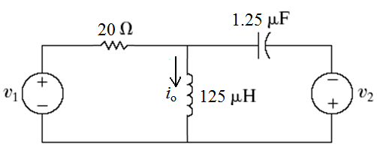
Chapter 9 – Sinusoidal Steady-State Analysis (22 of 26)
Find the expression for
in the circuit below, given
and

Slide 24


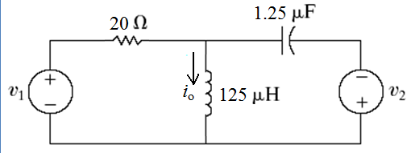


Chapter 9 – Sinusoidal Steady-State Analysis (23 of 26)
Which formula should we use to calculate the impedance of
the inductor? Remember that
and
A.
B.
C. The average of A and B
D. Both A and B

Slide 25



Chapter 9 – Sinusoidal Steady-State Analysis (24 of 26)
Find the expression for
in the circuit below, given
and
When the time domain sinusoidal sources have different frequencies, we must use superposition, phasor transforming and analyzing the circuit for each source individually.

Slide 26


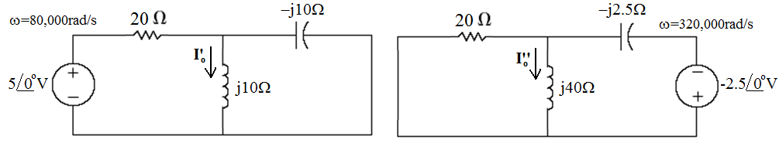

Chapter 9 – Sinusoidal Steady-State Analysis (25 of 26)
Find the expression for
in the circuit below, given
and
After source transform and current division,
  Inverse phasor transform each current phasor, then add the two time domain expressions:

Slide 27


Chapter 9 – Sinusoidal Steady-State Analysis (26 of 26)
Find the expression for
in the circuit below, given
and
After source transform and current division,

Slide 28

Copyright
This work is protected by United Kingdom copyright laws and is provided solely for the use of instructors in teaching their courses and assessing student learning. Dissemination or sale of any part of this work (including on the World Wide Web) will destroy the integrity of the work and is not permitted. The work and materials from it should never be made available to students except by instructors using the accompanying text in their classes. All recipients of this work are expected to abide by these restrictions and to honor the intended pedagogical purposes and the needs of other instructors who rely on these materials.

